Slide 1


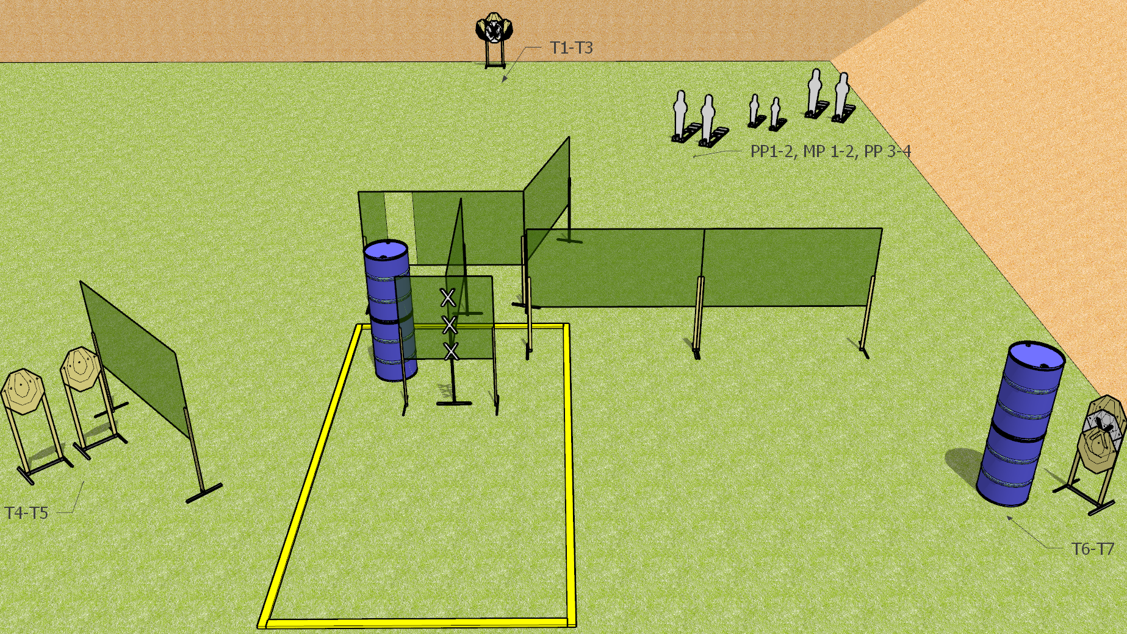
 | Dothan Gun Club – USPSA Match Where Will I Go? Course Designer : Drew Coleman
START POSITION : Hands placed palms covering upper two marks on wall. PCC muzzle touching lowermost mark
GUN READY CONDITION : Pistol loaded and holstered. PCC shouldered, muzzle touching bottommost mark on wall. |  | SCORING: Comstock, 20 rounds TARGETS: 7 paper, 6Steel SCORED HITS: Best 2 on paper, steel until down START-STOP: Audible, last shot RULES: Failing to fire strong hand only for last 6 required hits of last array will be a procedural per non-SHO shot fired
STAGE PROCEDURE: Engage target arrays in any order, last 6 shots of last array must be engaged strong hand only. Array 1: T1-T3 Array 2: PP1-PP4, MP1-2 Array 3: T4-T7

